Slide 1
Case study: Airport
Passengers chek-in and boarding.
Exceptions:
The passenger only has carry-on luggage.
The passenger doesn't buy anything at the newsstand.
The passenger is running late and now has to check in as quickly as possible.
The passenger loses his or her boarding pass.
The passenger arrived by plane and merely has to change planes, meaning that he or she doesn't leave the transit area.
...
Source making https://sourcemaking.com

Slide 2
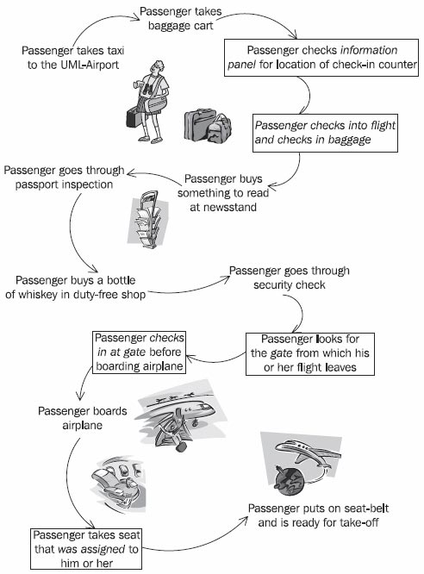

Slide 3
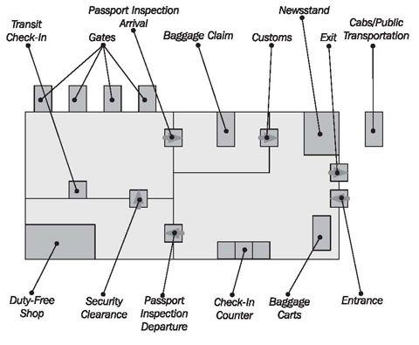

Slide 4
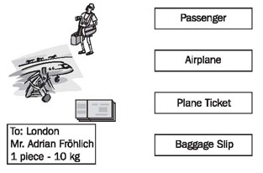
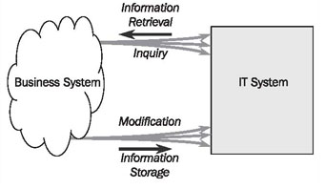
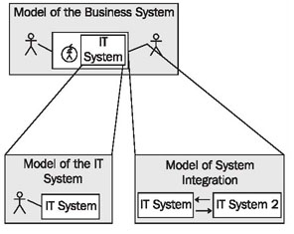
Information System and IT System
Objects in real world an in Information system
IT System
Models of the case study

Slide 5
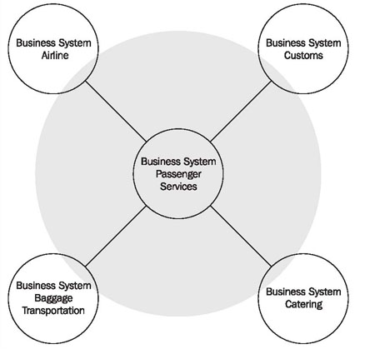
Business System
Passenger Services
System boundary during analysis of the business system

Slide 6

Business Processes
Activity of the business process "Passenger Services" (simplified)

Slide 7
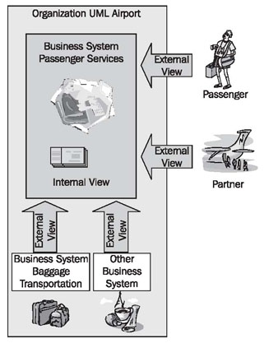
One Model-Two Views
External and internal view of the business system

Slide 8
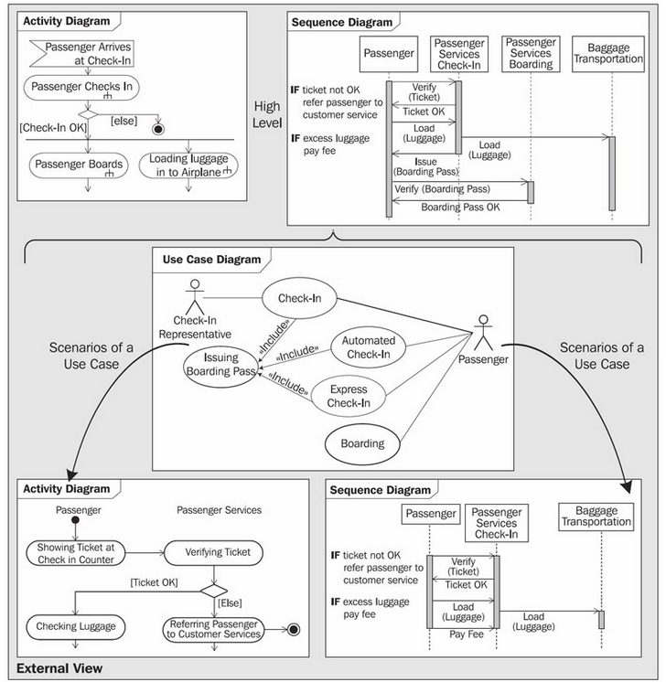

Slide 9
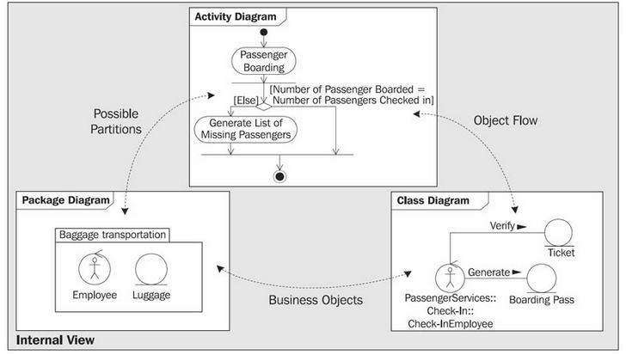

Slide 10
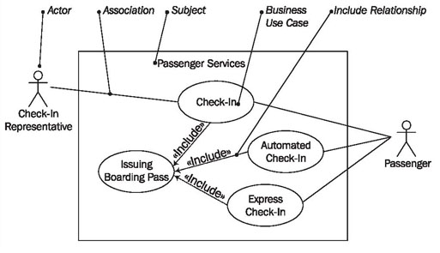
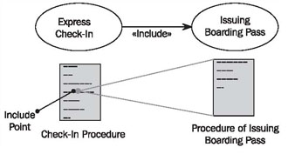
Use Case Diagrams
The elements of the use case diagram
The include relationship between use cases

Slide 11
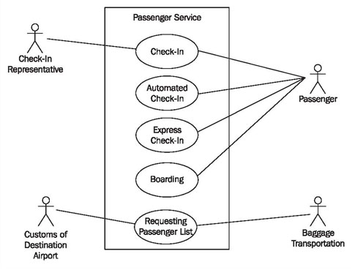
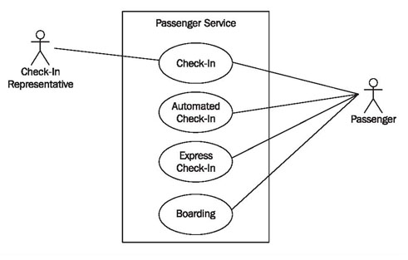
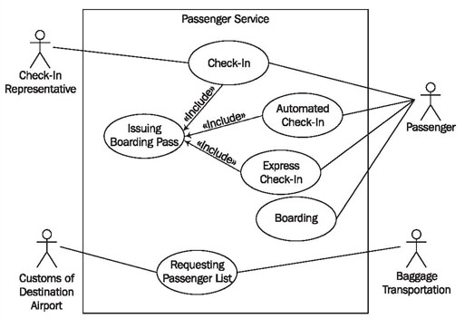

Slide 12
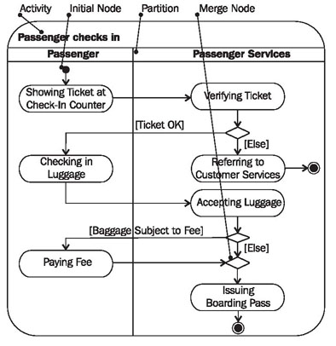
Activity Diagrams
Activity diagram of the activity "Passenger checks in"

Slide 13
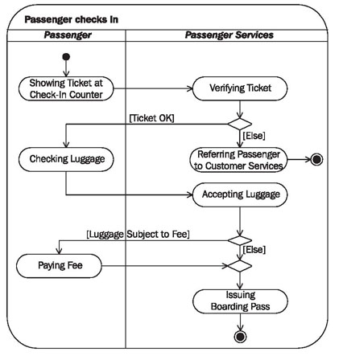
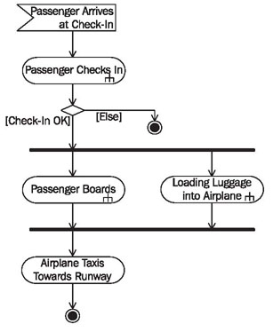
Activity diagram "Passenger Services" with a low level of detail ("High Level")
Activity diagram of the activity "Passenger checks in"

Slide 14
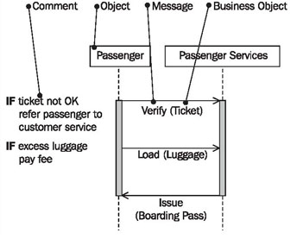
Sequence Diagrams
Sequence diagram "Passenger Check-In"

Slide 15
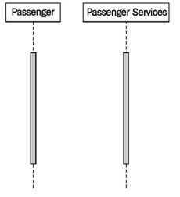
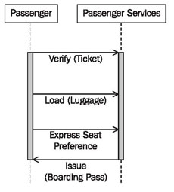
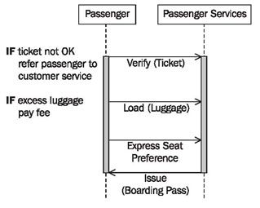
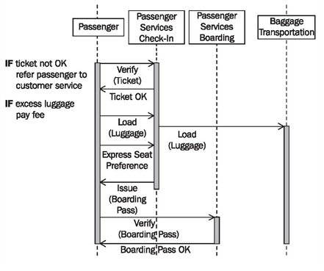

Slide 17
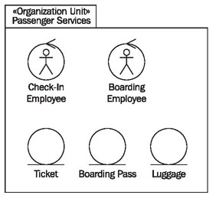
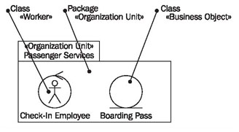
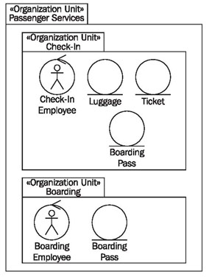
Package Diagram
Package diagrams describe the organization units in the form of packages

Slide 18
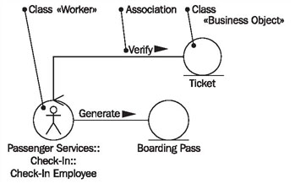
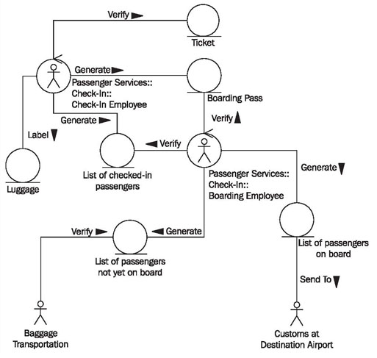
Class Diagram
(Business System)

Slide 19
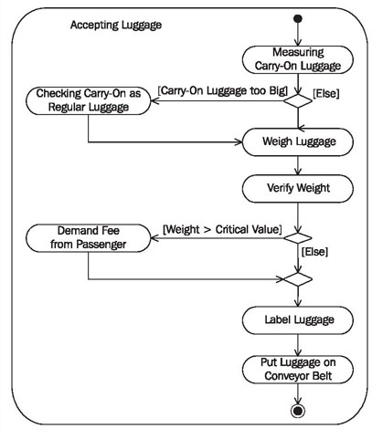
Activity Diagram

Slide 20
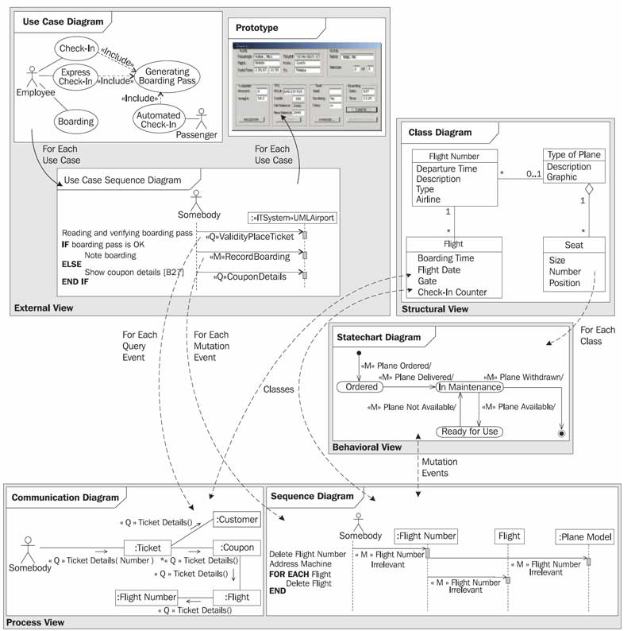
Different views of an IT system

Slide 21
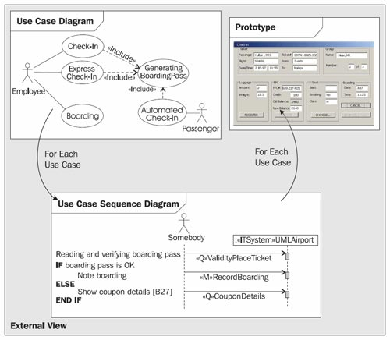
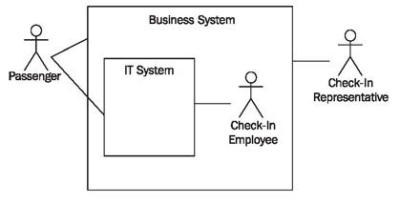
IT System: External View
Actors of the business system and IT system

Slide 22
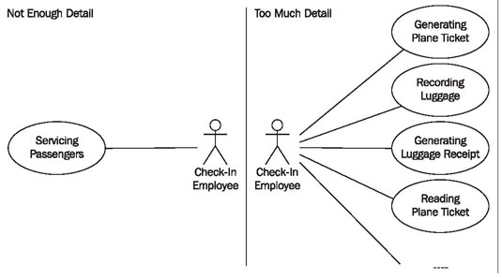
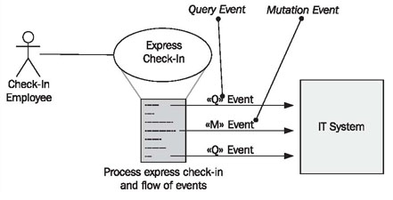
Actors of the business system and IT system
Use Case Diagram
Business System

Slide 23
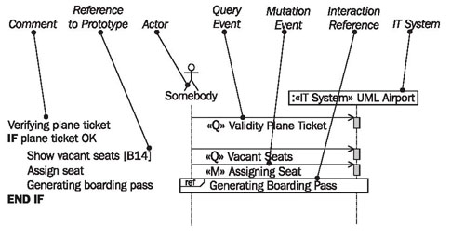
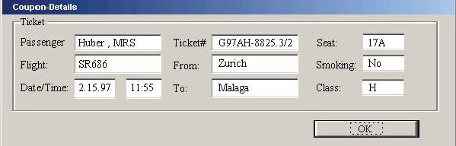
IT System: Use Case Sequence Diagram
Dialog window prototype

Slide 24
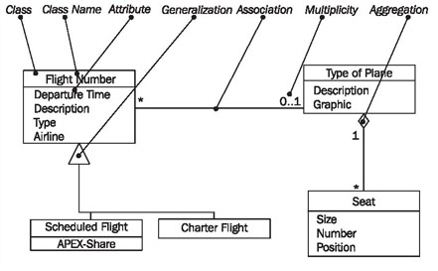
IT System: Class Diagram

Slide 25

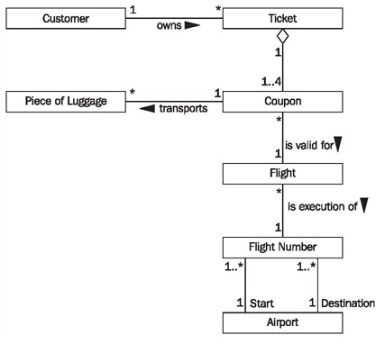
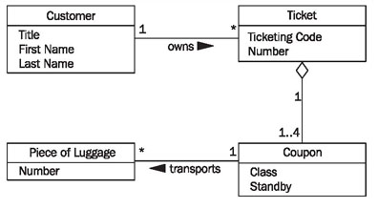
IT System: Class Diagram
Potential classes
Class and Associations
Classes and Attributes

Slide 26
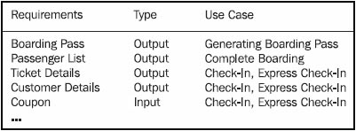
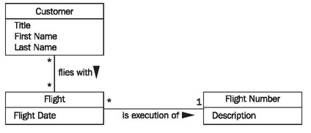
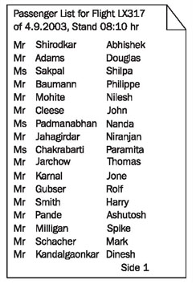
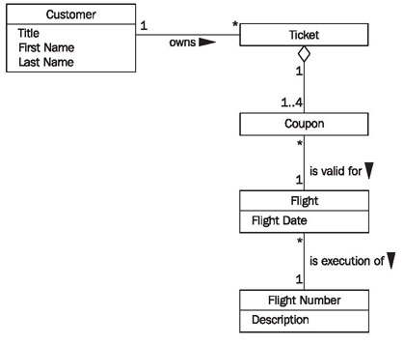
IT System: Class Diagram
List Required Queries and Inputs
Class diagram for Passenger list
Passenger list

Slide 27
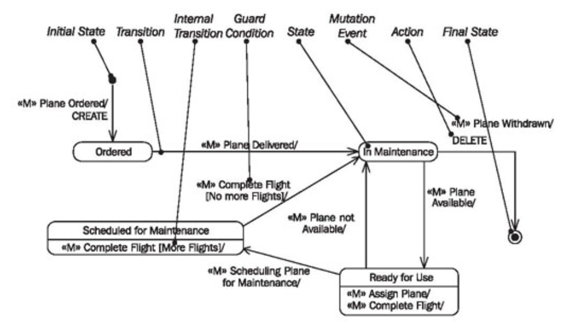
IT System: Statechart Diagram
Statechart diagram for the frequent flyer card

Slide 28
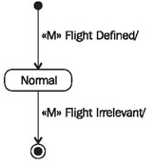
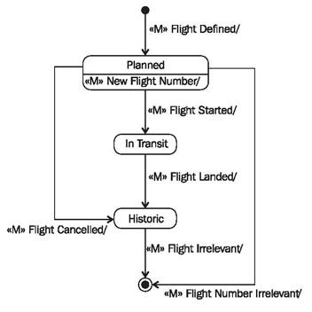
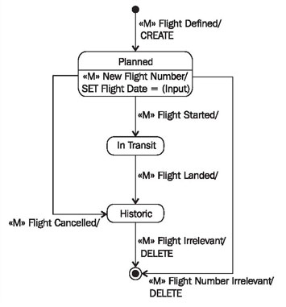
IT System: Statechart Diagram
Statechart diagram of the class "Flight"
+ actions

Slide 29
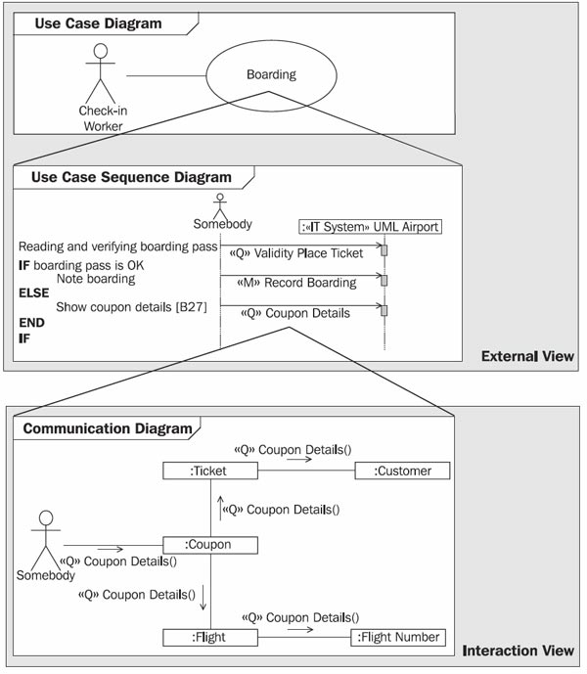
IT System: Communication Diagram

Slide 30
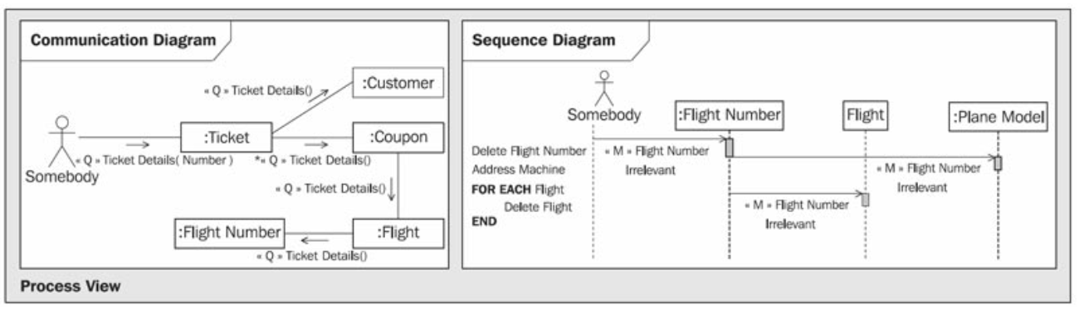
IT System: Communication Diagram

Slide 31
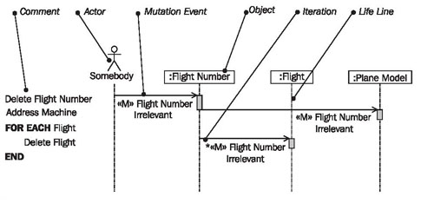
IT System: Sequence Diagram

Slide 32
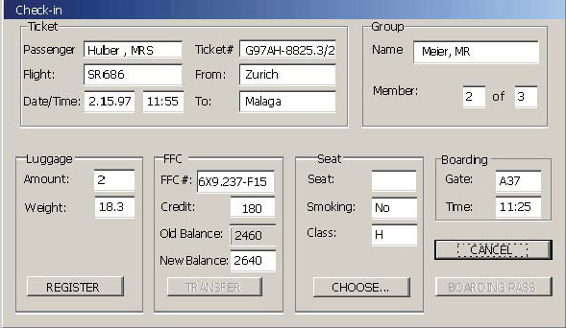

IT System: Communication Diagram
Interface prototype from the passenger check-in system
Part of a boarding pass

Slide 33

IT System: Communication Diagram
Part of a boarding pass

Slide 34

IT System: Communication Diagram
Part of a boarding pass
Event path

Slide 35


IT System: Communication Diagram

Slide 36

IT System: Sequence Diagram

